Slide 1


Project Technikon
By: Chaidou Elena

Slide 2

Introduction
Converting the java Technikon project into a web application

Slide 3

01
Backend: Java with Jakarta EE
02
Frontend: Angular
Technologies Used
03
Server: WildFly hosting the backend application.
04
API Testing: Postman
05
Database: MySQL for storing project data.

Slide 4
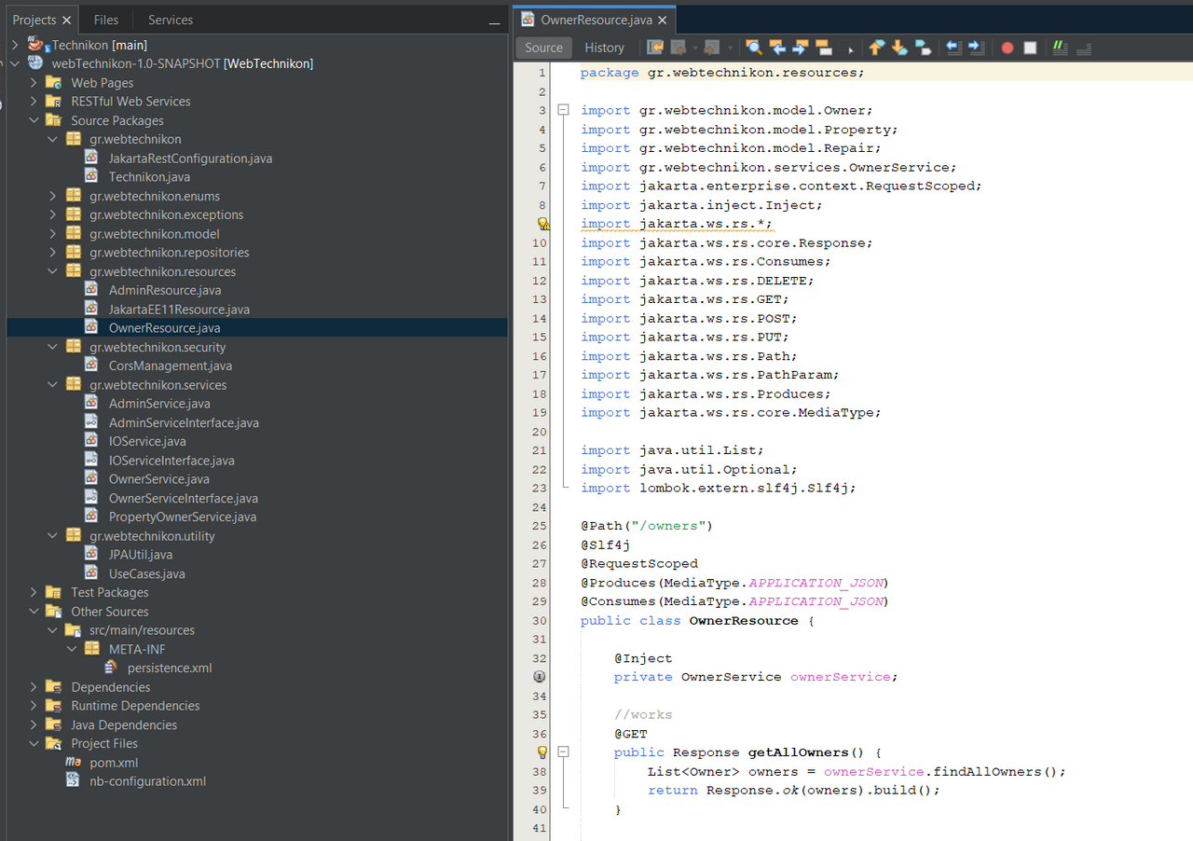
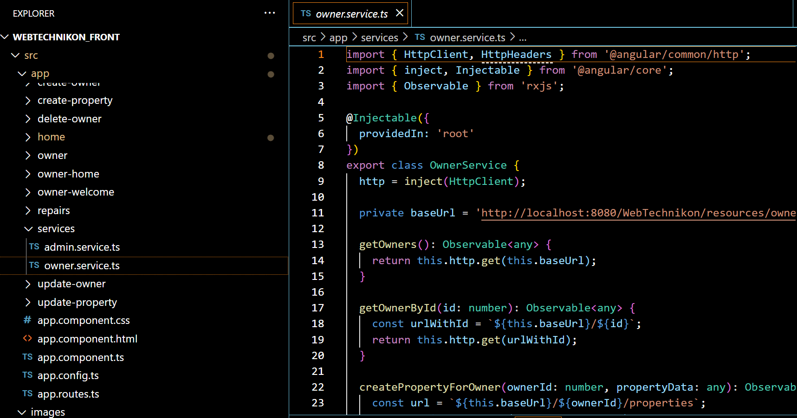
Back-End Structure
Front-End Structure

Slide 5
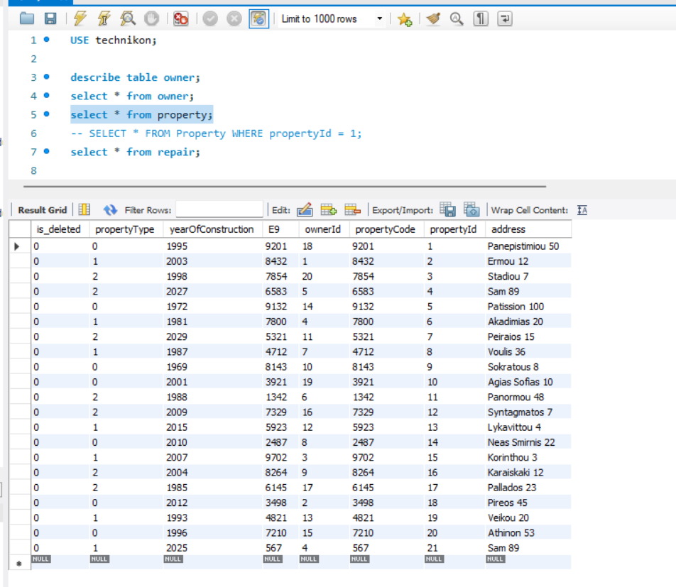
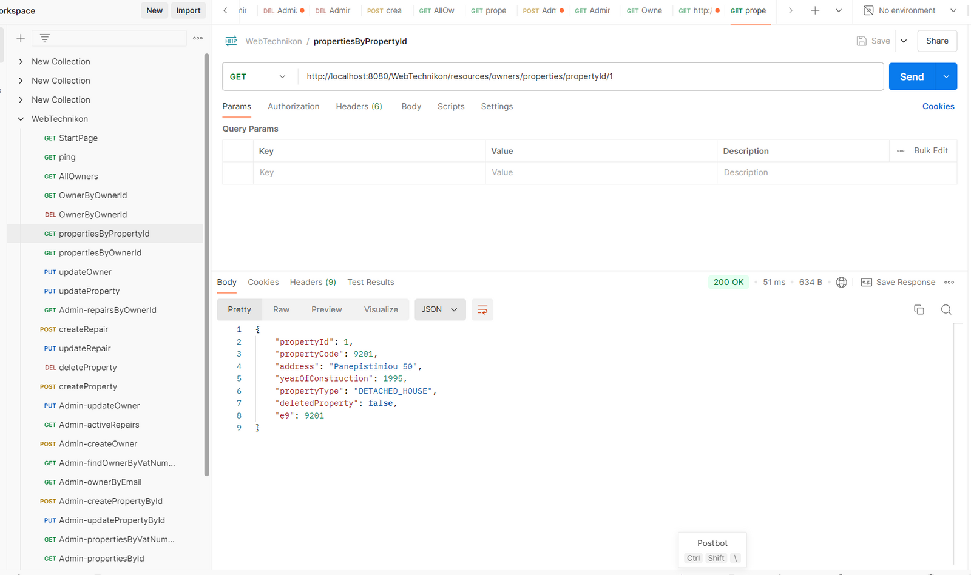
MySQL Workbench
Postman

Slide 6


Challenges
1
2
Complexity: Understanding Angular's structure and features.
API Integration: Making sure the Angular frontend communicated well with the backend APIs

Slide 7

THANK YOU!

